Slide 1
Genetic algorithm to solve the Knapsack problem

Slide 2
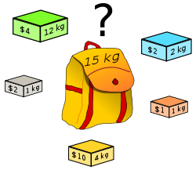

Knapsack problem
Given a set of items, each with a mass and a value, determine the number of each item to include in a collection so that the total weight is less than or equal to a given limit and the total value is as large as possible
Here we solve the “0-1” knapsack problem, i.e. any item is either not present (“0”) or is present once (“1”)
We have 5 items, each with its corresponding weight and value. E.g. the 3rd item has a weight of “6” weight units and a value of “900” value units
We represent each member of the population i.e. each “gene” by a 5-bit string. E.g. the string (1,1,1,0,0) indicates that this solution has the 1st 3 items present and the last 2 absent

Slide 3
Program flow
We generate a population of 2000 random genes
In each generation, we first calculate the “fitness” of each member of the population i.e. we calculate the total value of each member of the population. E.g. (1,1,1,0,0) has a value of 1900
We calculate total weight of each gene. E.g. (1,1,1,0,0) has a weight of 10
For all genes that exceed the weight threshold, we set their value as “-1” to indicate that such genes are ineligible and must be given a penalty
Now we take a sample of 20 genes from the population of 2000 to save computation time. Rather than looking for the “fittest” individuals in the whole population, we look for them just in the sample
We select the two strongest parents from the sample and create two children from them by crossing-over their genes at a random splicing point. Then we mutate the children

Slide 4
Program flow
Now, we find the two least fittest genes in the sample and replace them with the 2 newly created children
Now we merge the sample of 20 back into the population. Once again, the population has 2000 individuals
This was 1 generation. We repeat the above process for 3000 generations
Finally we analyze the sample of 20 genes in the end and check if we have found good solutions

Slide 5
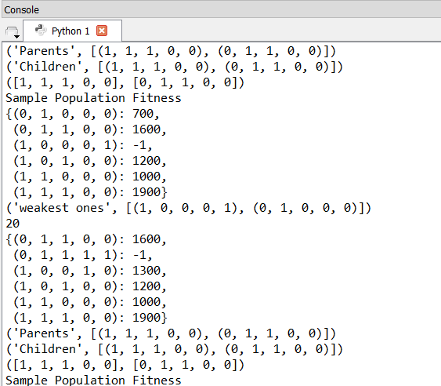
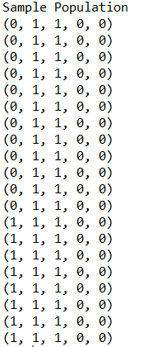
Results
We see that gradually the sample population has fewer genes corresponding to invalid (“-1”) and lower fitness scores
Finally in the end, the sample population is concentrated with only the highest value genes that satisfy the constant
Here we see that the sample population in the end has 12 instances of (0,1,1,0,0) with a value of 1600 and 8 instances of (1,1,1,0,0) with a value of 1900

Slide 6
References
“Machine Learning and discovery” by Prof. Vemuri, UC Davis, http://www.cs.ucdavis.edu/~vemuri/classes/ecs271/Genetic%20Algorithms%20Short%20Tutorial.htm
Genetic Algorithm Tutorial by Prof. Darrell Whitley, Computer Science Department, Colorado State University, http://samizdat.mines.edu/ga_tutorial/ga_tutorial.ps
A tutorial on “The 0-1 Knapsack Problem” by Prof. Arup Guha, CS Department, University of Central Florida, http://www.cs.ucf.edu/~dmarino/ucf/cop3503/lectures/DynProgKnapsack.doc

